Slide 1
Changing matter
The chocolate investigation

Slide 2
What do i want to find out?
I want to find the temperature that melts the chocolate the fastest.

Slide 3
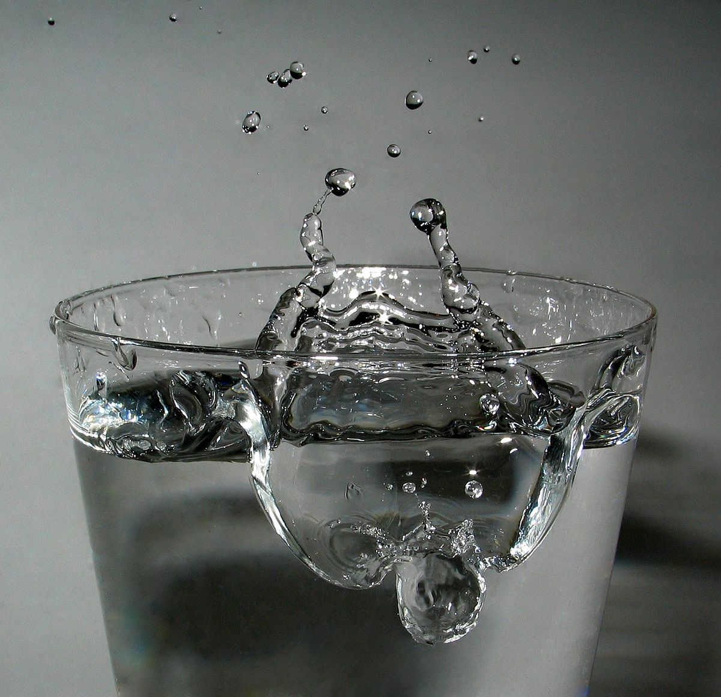
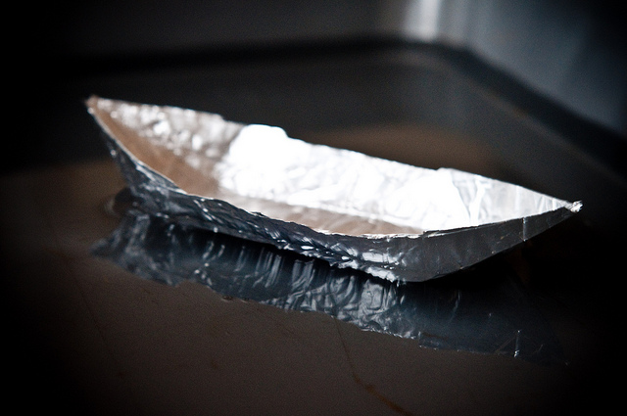
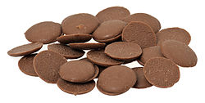
Equipment
x3 bowls
Items I will need for this experiment.
Boiling water, warm water and cold water
x3 tin foil boats
x3 chocolate buttons
This Photo by Unknown Author is licensed under CC BY-SA

Slide 4
Method – what I will do
I will float the pieces of chocolate in the foil tins on bowls filled with different temperatures of water.
So that my results are reliable I will keep the bowl size, the volume of the water, thickness of the foil and the amount of chocolate the same. The only thing that will change is the temperature of the water.
I will measure the time it takes for the matter to visibly change, and the size of the chocolate buttons as they melt.
I will observe any changes to the chocolate buttons.

Slide 5
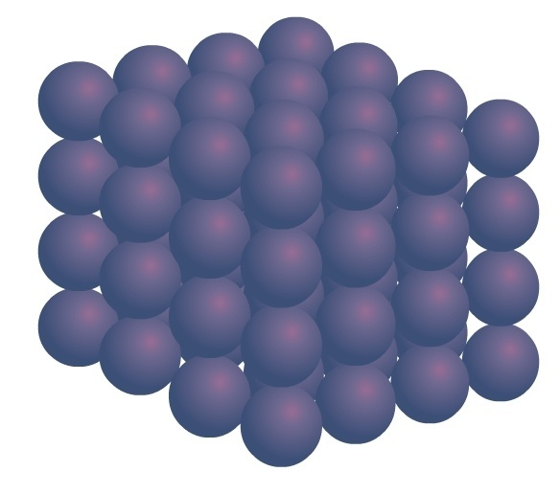
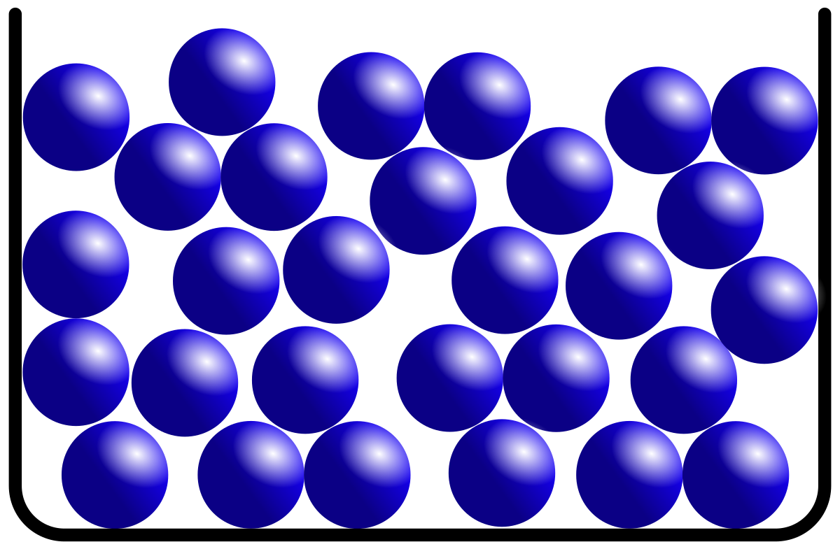
Prediction
I think that the chocolate in the hot water will melt the fastest, the warm one will be next and the last one is cold. I predict this will happen because when tight solid particles are heated up they start to vibrate and move faster and faster. They start moving around each other and becoming liquid particles.
What do I think will happen?
Melting
This Photo by Unknown Author is licensed under CC BY-ND
This Photo by Unknown Author is licensed under CC BY-SA

Slide 6
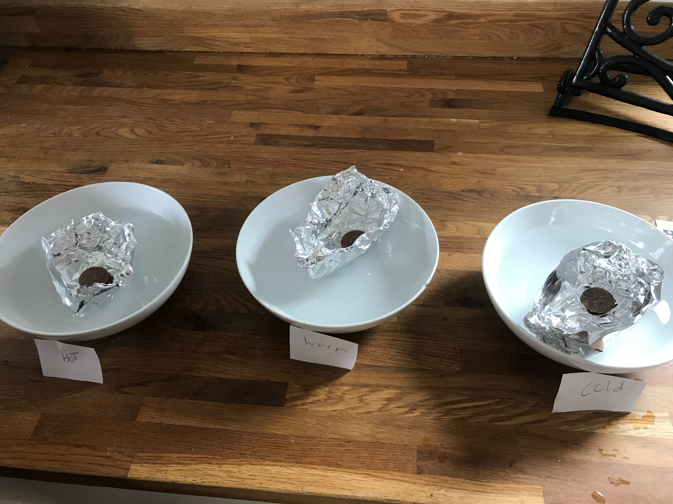
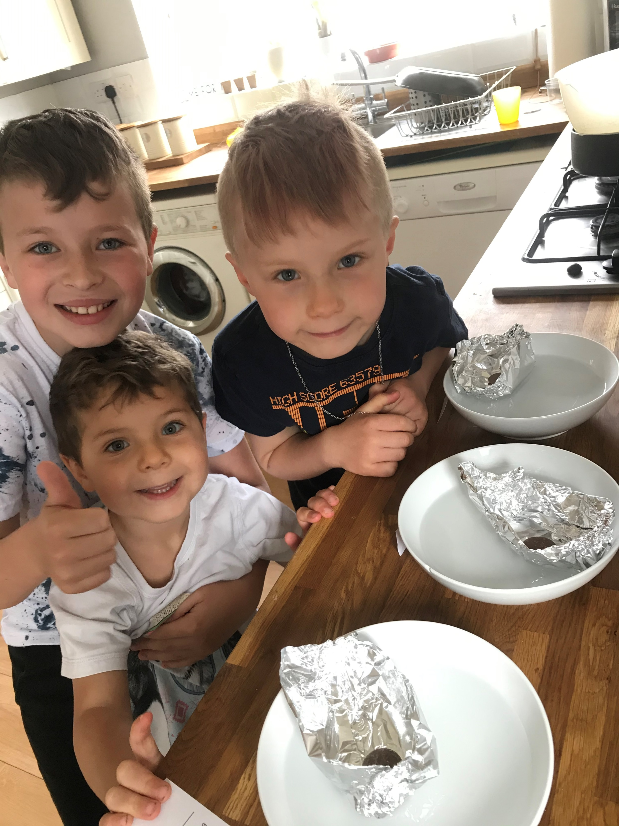
results
 | Bowl 1 | Bowl 2 | Bowl 3 | Over pan of boiling water
Temperature of water | Hot | Warm | Cold | Boiling
Time taken for chocolate to melt. | 8mins | 8mins | Experiment stopped at 8 minutes | 4mins 15secs

Slide 7
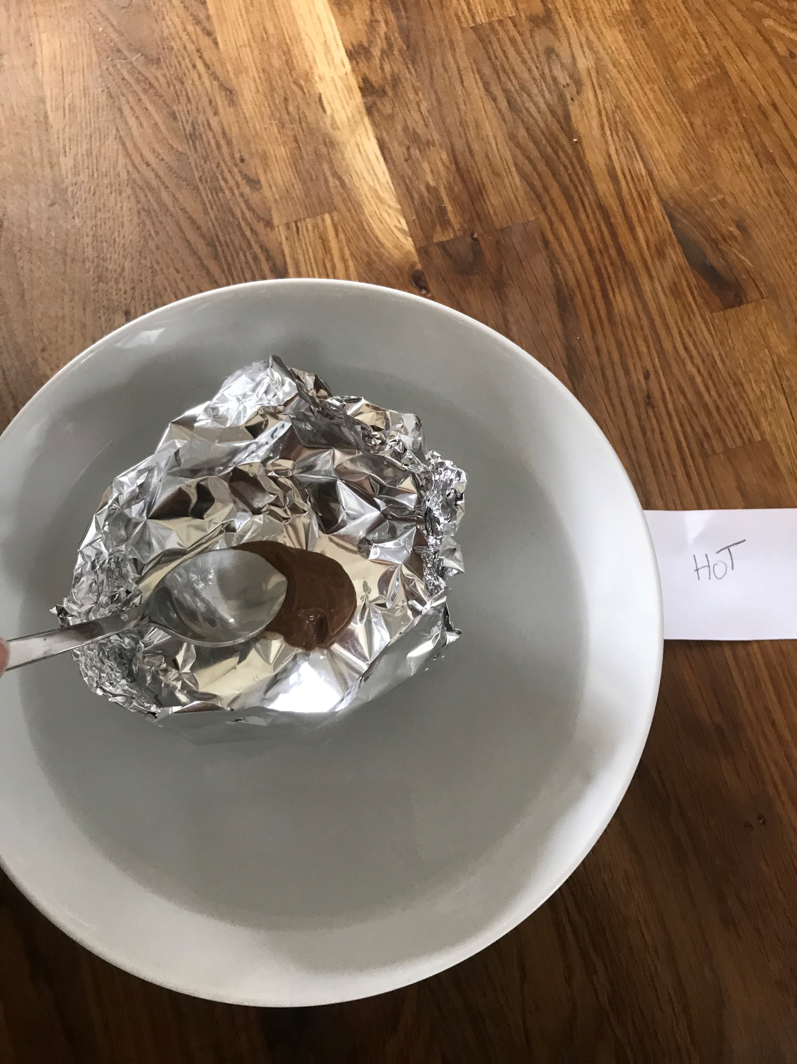
results
In my experiment the chocolate in the hot bowl had definitely melted at eight minutes.
It had changed from a solid to a liquid.

Slide 8
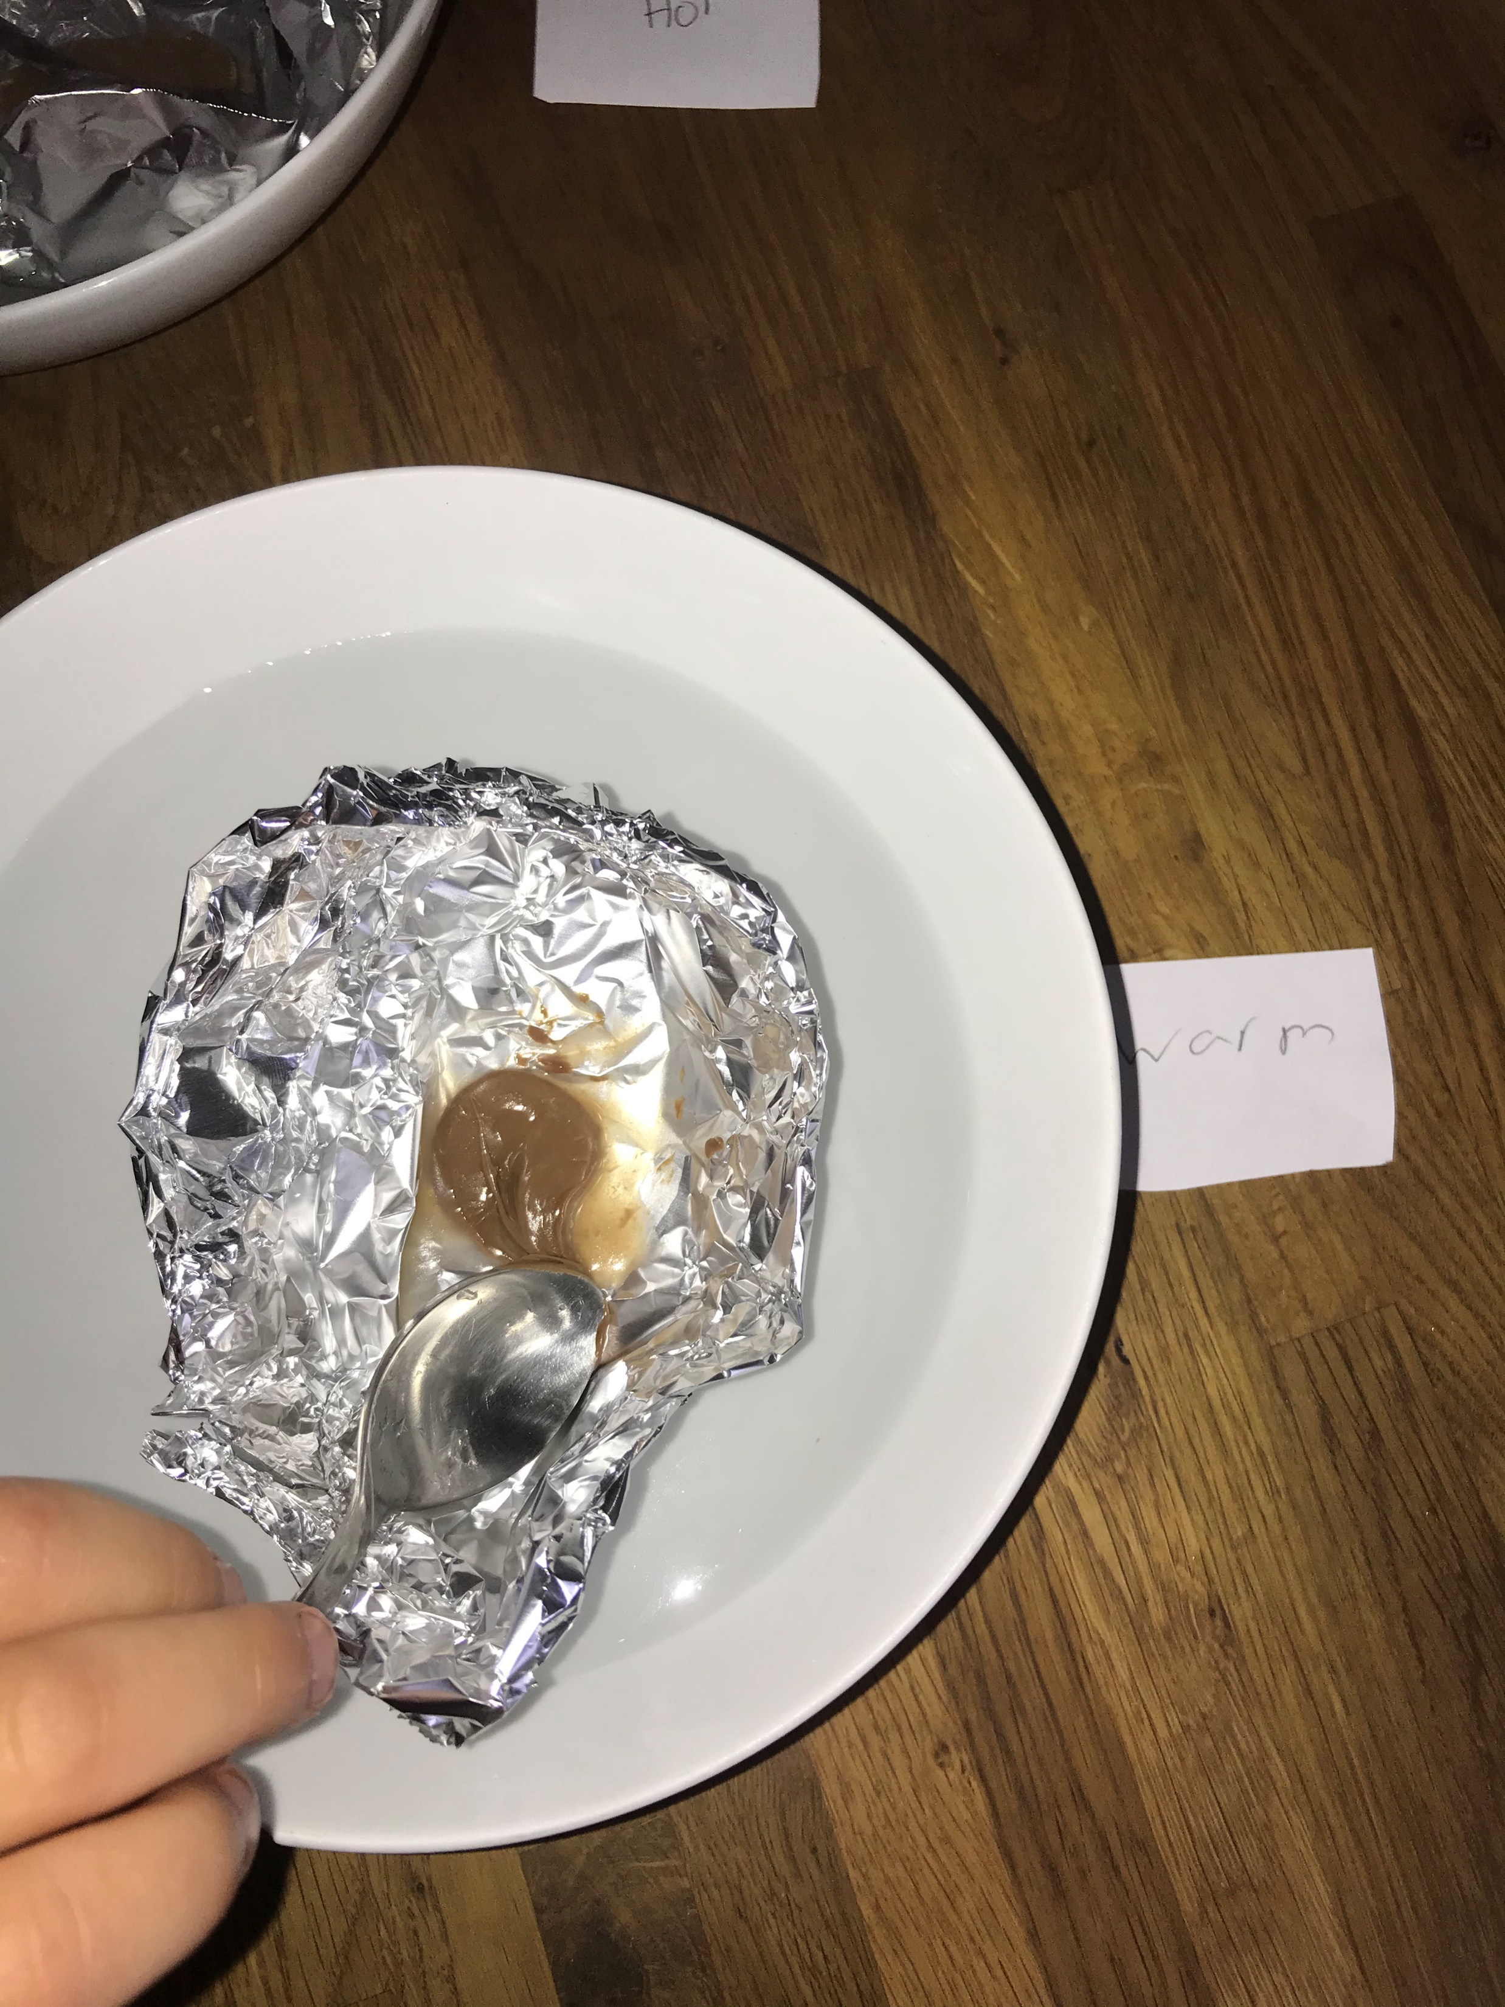
results
The chocolate in the warm bowl held it’s shape but was soft at eight minutes.
There was a small change.

Slide 9
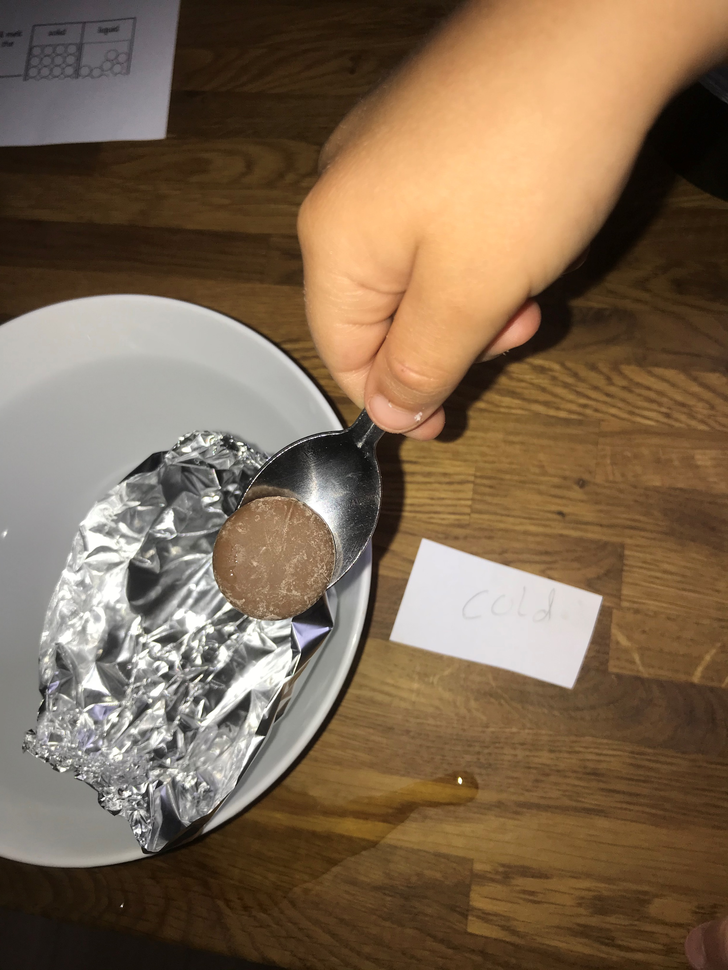
results
The chocolate in the cold water bowl was still solid and kept it’s shape.
There was no change.

Slide 10
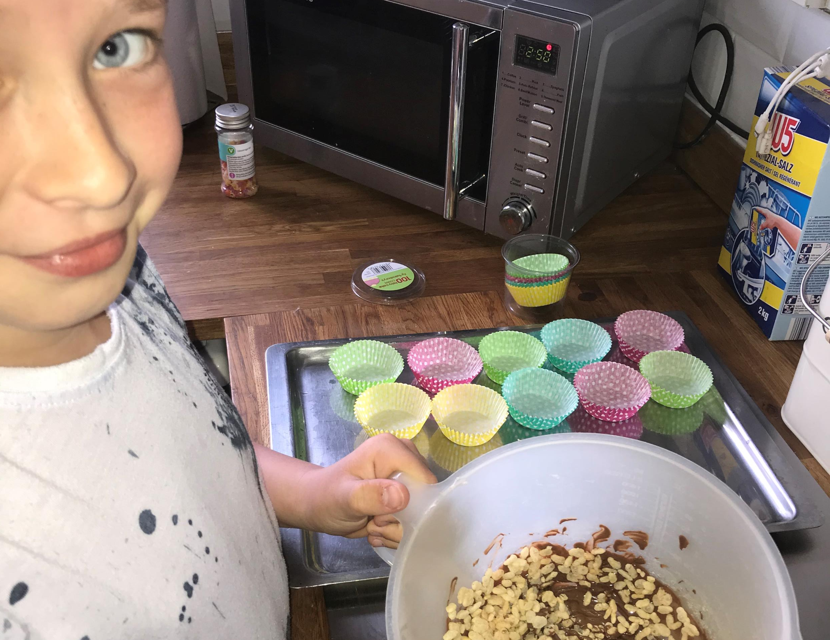
results
As a separate experiment we put many chocolate buttons in a bowl over constantly boiling water. These melted much faster at four minutes and 15 seconds.
With this chocolate we made crispy cakes by mixing in rice crispies. We then put them in the fridge and cooled them back to a solid.

Slide 11
conclusion
Boiling hot water melts the chocolate the fastest because the particles are constantly being heated and changed.

