Slide 1
Fossils
By Shona G

Slide 2
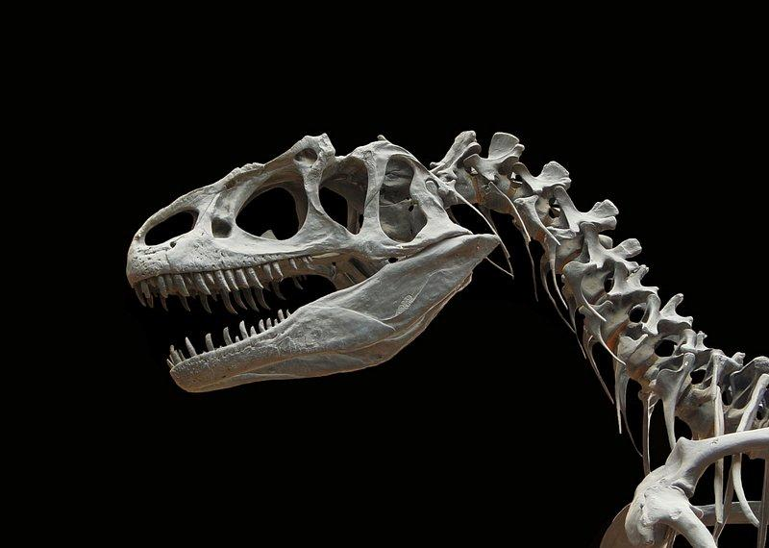
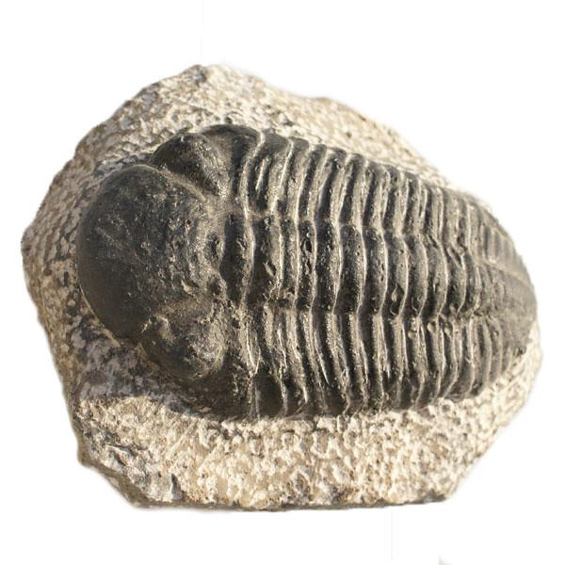
What are fossils?
Fossils are the remains or traces of prehistoric insects, plants or animals. It is very rare for a living thing to become fossilised.

Slide 3
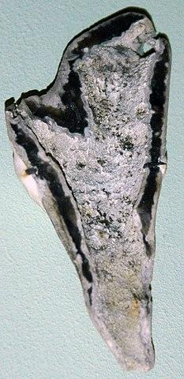
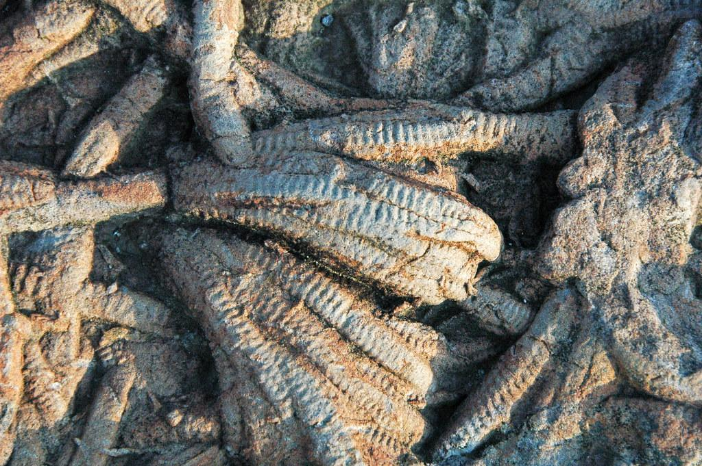
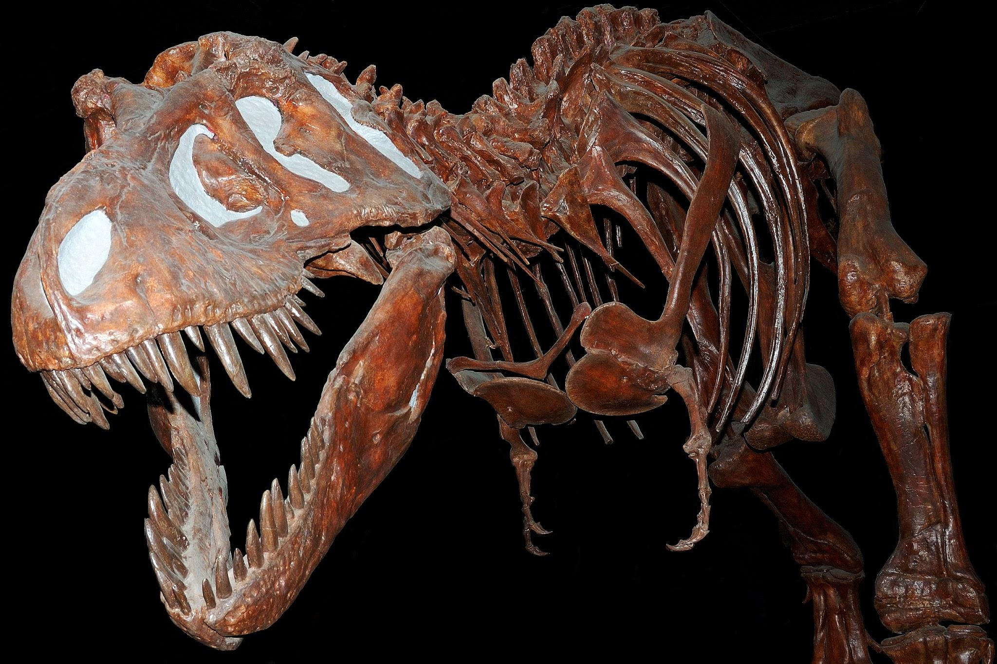
What Types of Fossil Are There?
There are three main types of fossils: chemical fossils, body fossils and trace fossils.
Chemical fossils contain carbon. This is proof that they were once living things. Examples include petroleum oil, coal and gas.
Body fossils are the remains of an animal or plant, such as bones, shells or leaves.
Trace fossils record the activity of an animal. Examples include footprints, trackways and Coprolites.

Slide 4
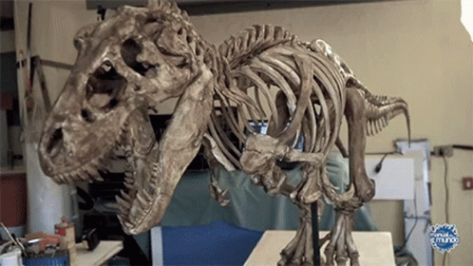
How are fossils formed
Fossils are formed through a process called fossilisation. This takes place over thousands of years.
First, an animal or creature dies on land or in the sea and is covered by a layer of sand, volcanic ash or mud. Most of the remains rot away but harder parts, such as bones and teeth, remain.
Over time, more layers of sediment cover the buried remains. This puts pressure onto the layers below and forms sedimentary rock.
Water seeps into the bones and teeth, leaving mineral deposits. Sometimes, the water dissolves the bone and minerals or sediment fill the space in the mould. This creates a rock replica of the original bones, teeth, leaves or footprints and become a fossil.

Slide 5
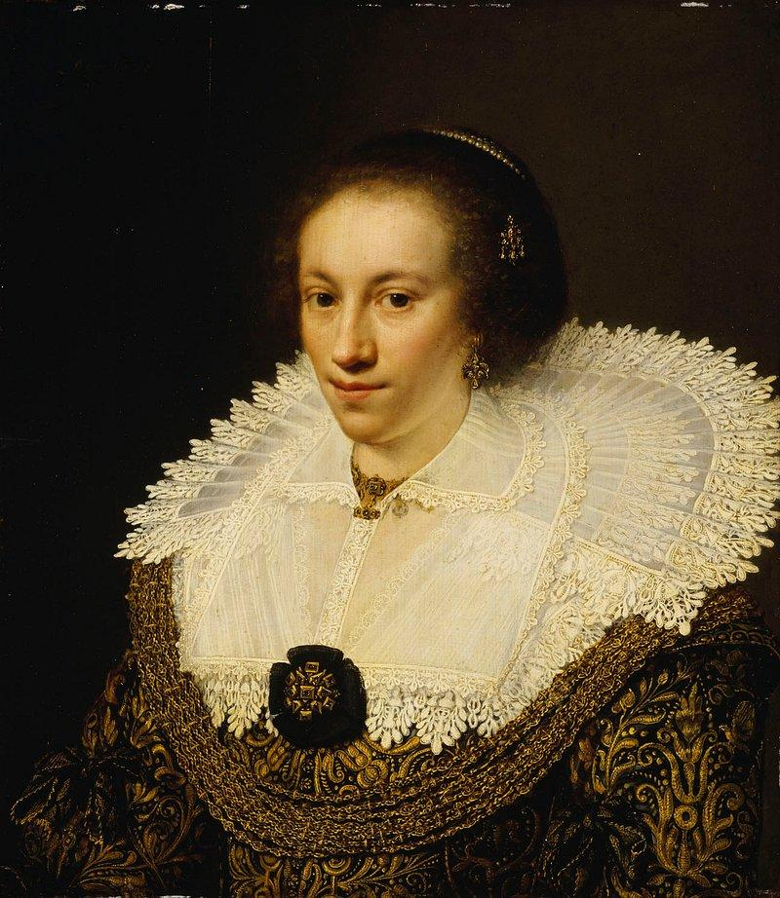
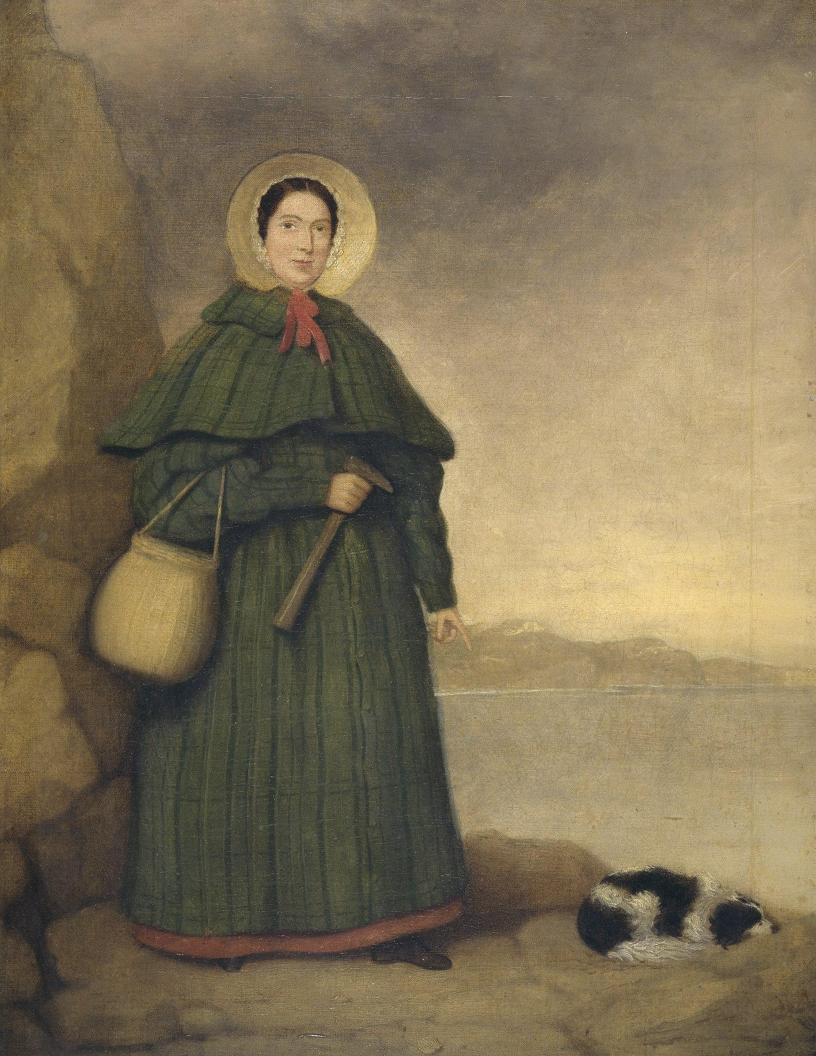
Did you know?
Did you know that a women named Mary Anning was a famous fossil hunter from the United Kingdom. Alone with Elizabeth Philpot, she made the first discovery complete fossils.

