Slide 1
Week 6 – Home Learning
Warm-Up Challenge
Warm Up Challenge
Warm your brains up thinking about the above questions

Slide 2
Teaching Input:
Week 6 – Home Learning

Slide 3
Teaching Input:
Week 6 – Home Learning

Slide 4
Teaching Input:
Week 6 – Home Learning

Slide 5
Teaching Input:
Week 6 – Home Learning

Slide 6
Teaching Input:
Week 6 – Home Learning

Slide 7
Teaching Input:
Week 6 – Home Learning

Slide 8
Teaching Input:
Week 6 – Home Learning

Slide 9
Teaching Input:
Week 6 – Home Learning

Slide 10
Teaching Input:
Week 6 – Home Learning

Slide 11
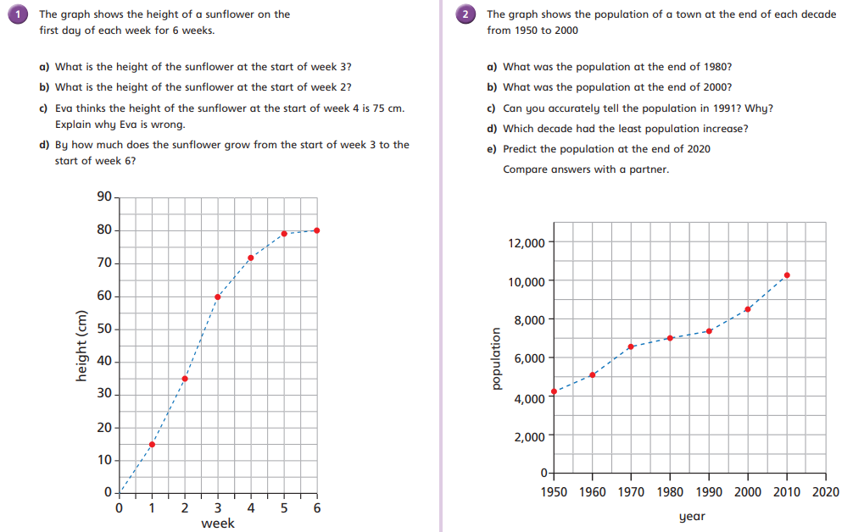
Independent Activity: Now grab a pen and paper and see how many questions you can answer
Week 6 – Home Learning
Bees:

Slide 12
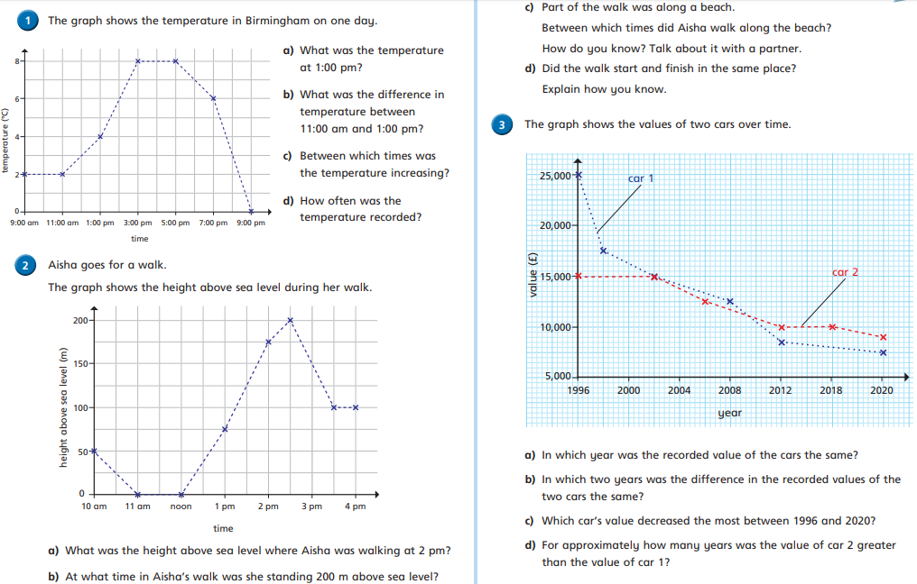
Independent Activity: Now grab a pen and paper and see how many questions you can answer
Week 6 – Home Learning
Beetles:

Slide 13
Mastery Challenge:
Week 6 – Home Learning

